Slide 1

6th Grade Accelerated Math
Unit 5, Lesson 10 Converting Units Using Ratios Volume 1, pg. 219

Slide 2


Benchmark
MA.6.AR.3.5
Solve mathematical and real-world problems involving ratios, rates, and unit rates, including comparisons, mixtures, ratios of lengths and conversions within the same measurement system.
volume 1, pg. 219

Slide 3
Integrated Mathematical Thinking and Reasoning Standards
MA.K12.MTR.2.1 Demonstrate understanding by representing problems in multiple ways.
MA.K12.MTR.3.1 Complete tasks with mathematical fluency.
volume 1, pg. 219

Slide 4

Learning Target
I can use ratios to convert units within the same measurement system.
volume 1, pg. 219

Slide 5

Warm-Up
volume 1, pg. 219

Slide 6
5.10.1 Warm-Up: Furniture Designer
Jared Rusten is a woodworker who creates modern furniture in San Francisco.
Jared usually starts designing furniture by sketching his ideas before he makes a scaled drawing using measurements to build the actual piece of furniture. What do you think a scale drawing is?
Jared said, “I never thought that I’d be using math as much as I do now.” What are some of the ways he uses math as a furniture designer and maker?
volume 1, pg. 219

Slide 7

Guided Instruction
volume 1, pg. 220

Slide 8
5.10.2 Guided Instruction: Converting Units of Measure Using Ratio Relationships
Many different units are used to measure lengths, weight, capacity (volume), and time.
What are some units of measure that are used to take each type of measurement?
Length | Weight | Capacity | Time
volume 1, pg. 220

Slide 9
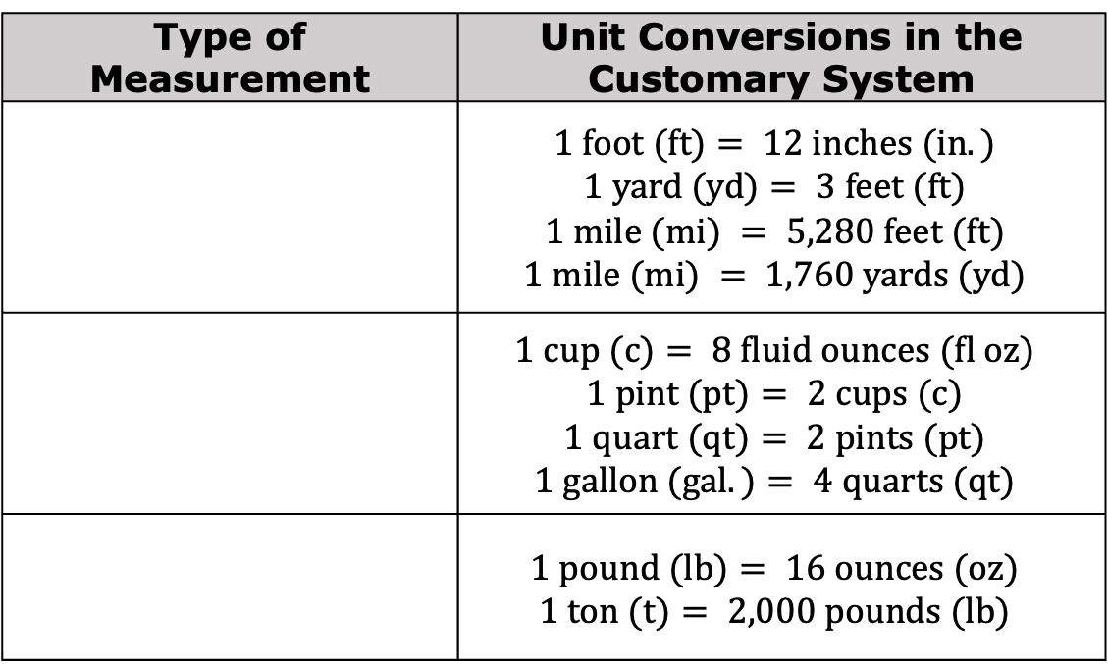
The United States uses the customary system of measurement. The table shows the unit conversions for units within this system.
Label each row using the words Length, Weight, and Capacity to indicate what each set of units measures.
Type of Measurement | Unit Conversions in the Customary System
 | $$1 foot (ft)= 12 inches (in.)$$ $$1 yard (yd)= 3 feet (ft)$$ $$1 mile (mi) = 5,280 feet (ft)$$ $$1 mile (mi) = 1,760 yards (yd)$$
 | $$1 cup (c)= 8 fluid ounces (fl oz)$$ $$1 pint (pt)= 2 cups (c)$$ $$1 quart (qt)= 2 pints (pt)$$ $$1 gallon (gal.)= 4 quarts (qt)$$
 | $$1 pound (lb)= 16 ounces (oz)$$ $$1 ton (t)= 2,000 pounds (lb)$$
volume 1, pg. 220

Slide 10
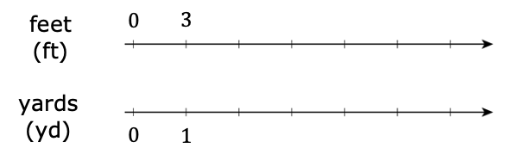
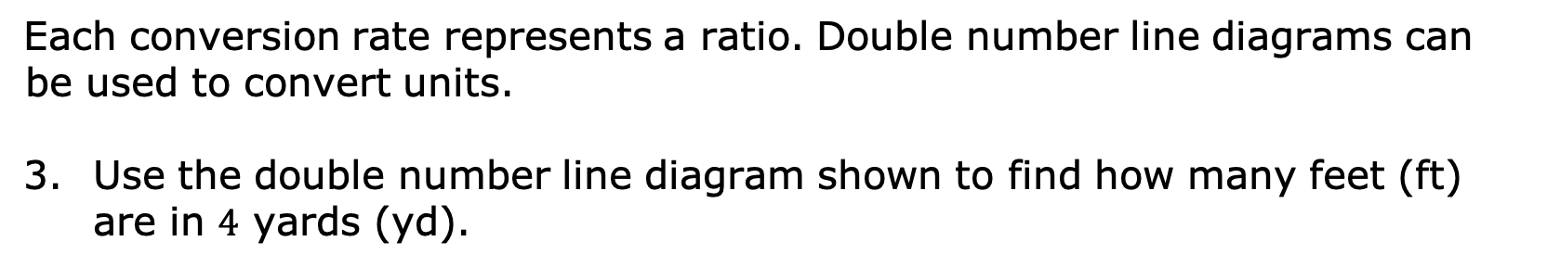
Each conversion rate represents a ratio. Double number line diagrams can be used to convert units.
Use the double number line diagram shown to find how many feet (ft) are in $4$ yards (yd).
There are ____ feet in $4$ yards.
volume 1, pg. 220

Slide 11
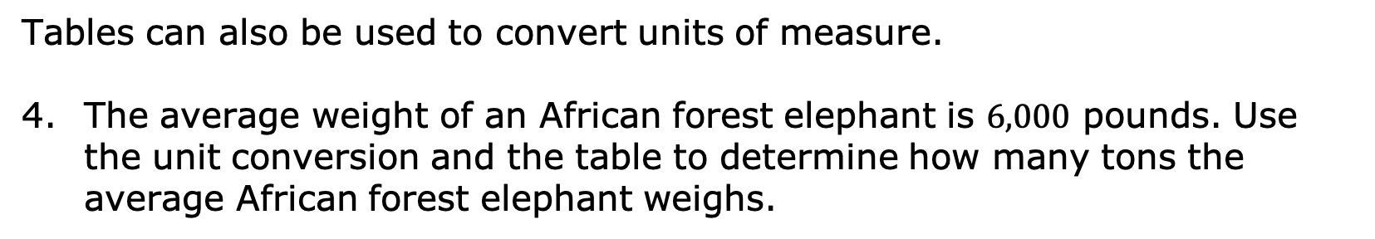
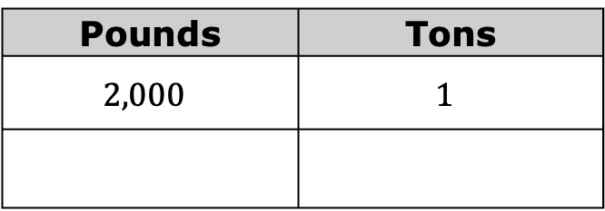
Tables can also be used to convert units of measure.
The average weight of an African forest elephant is $6,000$ pounds. Use the unit conversion and the table to determine how many tons the average African forest elephant weighs.
Pounds | Tons
$$2,000$$ | $$1$$
Notice that each conversion rate is a unit rate.
Unit rates can be used as factors to convert from one unit to another.
volume 1, pg. 220

Slide 12
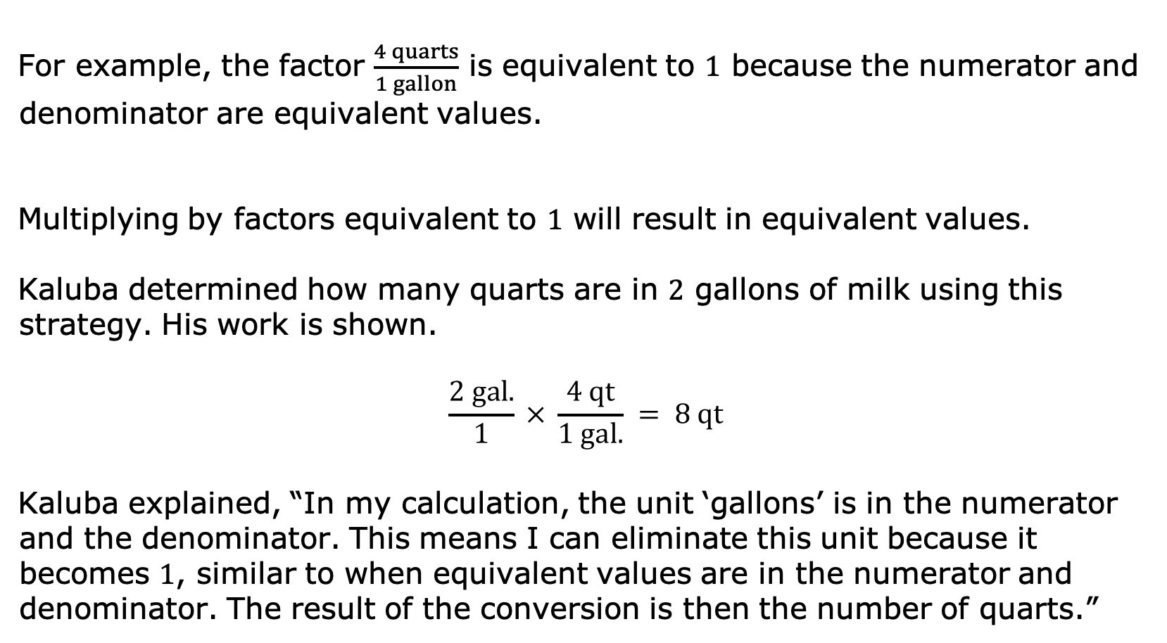
For example, the factor $\frac{4 quarts}{1 gallon}$ is equivalent to $1$ because the numerator and denominator are equivalent values.
Multiplying by factors equivalent to $1$ will result in equivalent values.
Kaluba determined how many quarts are in $2$ gallons of milk using this strategy. His work is shown.
$$\frac{2 gal.}{1} × \frac{4 qt}{1 gal.} = 8 qt$$
Kaluba explained, “In my calculation, the unit ‘gallons’ is in the numerator and the denominator. This means I can eliminate this unit because it becomes $1$, similar to when equivalent values are in the numerator and denominator. The result of the conversion is then the number of quarts.”
volume 1, pg. 221

Slide 13

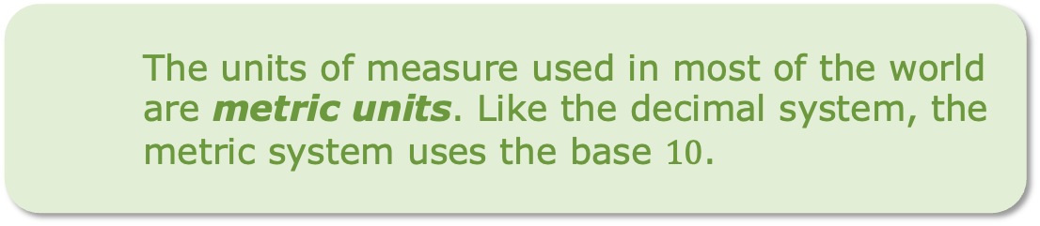
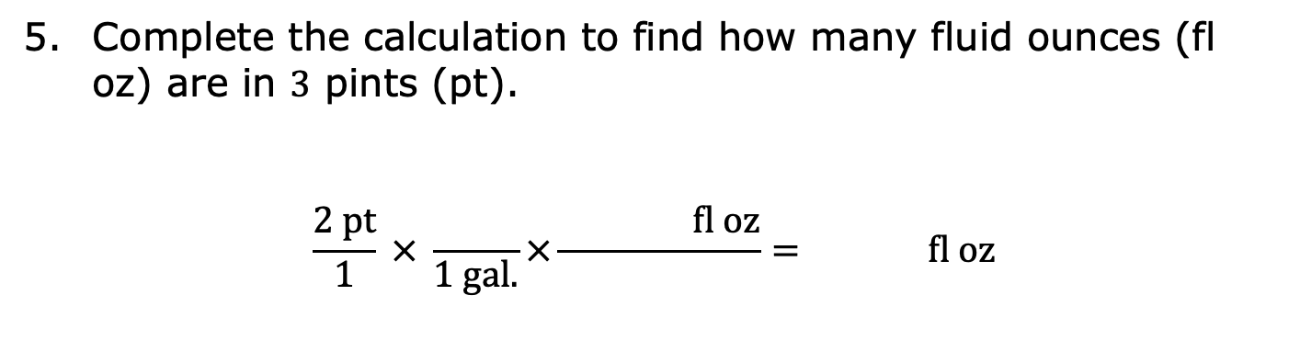
Complete the calculation to find how many fluid ounces (fl oz) are in $3$ pints (pt).
$$\frac{2 pt}{1} × \frac{}{1 gal.}×\frac{ fl oz}{}= fl oz$$
The units of measure used in the United States are customary units.
The units of measure used in most of the world are metric units. Like the decimal system, the metric system uses the base $10$.
volume 1, pg. 221

Slide 14
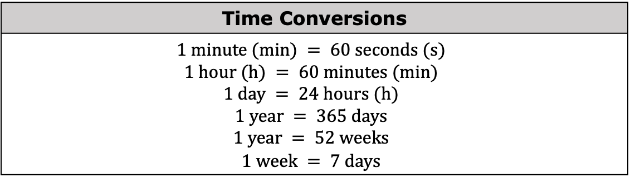
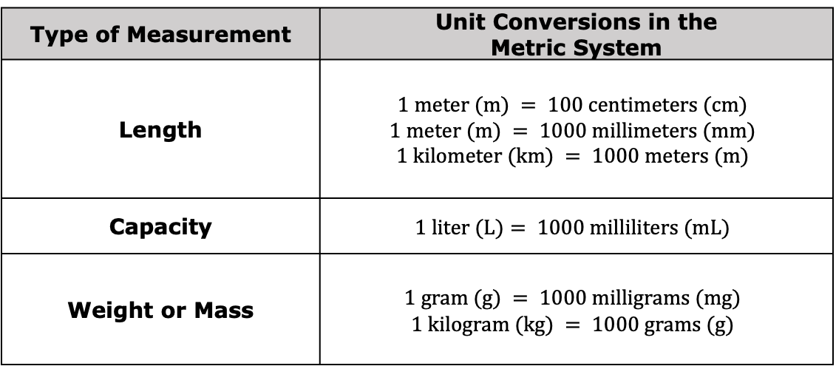
The tables below show additional unit conversion rates for other units of measure.
Type of Measurement | Unit Conversions in the Metric System
Length | $$1 meter (m) = 100 centimeters (cm)$$ $$1 meter (m) = 1000 millimeters (mm)$$ $$1 kilometer (km) = 1000 meters (m)$$
Capacity | $$1 liter (L)= 1000 milliliters (mL)$$
Weight or Mass | $$1 gram (g) = 1000 milligrams (mg)$$ $$1 kilogram (kg) = 1000 grams (g)$$
Time Conversions
$$1 minute (min) = 60 seconds (s)$$ $$1 hour (h) = 60 minutes (min)$$ $$1 day = 24 hours (h)$$ $$1 year = 365 days$$ $$1 year = 52 weeks$$ $$1 week = 7 days$$
volume 1, pg. 221

Slide 15

Guided Practice
volume 1, pg. 222

Slide 16


5.10.3 Guided Practice: Using Two-Column Ratio Tables
Use the conversion rates to find each value. Show your work.
$2.62$ km = ____ m
$9$ in. = ____ yd
$1$ week = ____ hours
volume 1, pg. 222

Slide 17

Adrian weighed $7$ pounds (lb) and $4$ ounces (oz) when he was born. How many ounces did Adrian weigh when he was born?
Ibuprofen is a medicine sometimes used for pain relief, such as for a headache. For adults, it is not safe to take more than $3200$ milligrams (mg) of ibuprofen each day. How many grams of ibuprofen is safe for adults to take in one day?
volume 1, pg. 222

Slide 18

Collaboration
volume 1, pg. 222

Slide 19
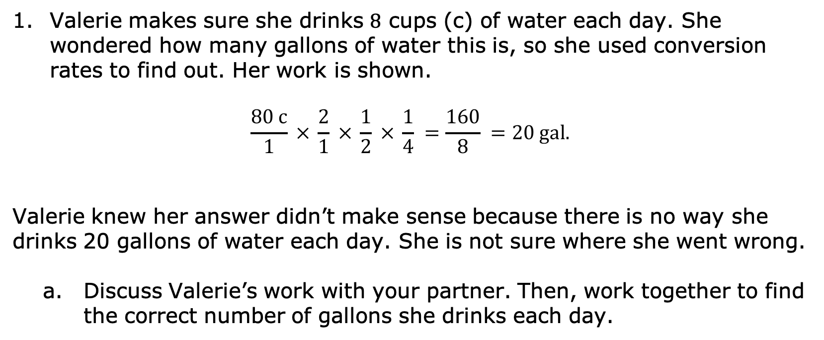
5.10.4 Collaboration: Error Analysis
Valerie makes sure she drinks $8$ cups (c) of water each day. She wondered how many gallons of water this is, so she used conversion rates to find out. Her work is shown.
$$\frac{80 c}{1} × \frac{2}{1} × \frac{1}{2} × \frac{1}{4} =\frac{160}{8} =20 gal.$$
Valerie knew her answer didn’t make sense because there is no way she drinks 20 gallons of water each day. She is not sure where she went wrong.
Discuss Valerie’s work with your partner. Then, work together to find the correct number of gallons she drinks each day.
volume 1, pg. 222

Slide 20
Help Valerie understand and learn from her mistakes. Write a brief note to Valerie explaining what her mistakes were and how she can learn from them. Include strategies that may be helpful.
Means
I
Start
To
Acquire
Knowledge
Experience
Skills
volume 1, pg. 223

Slide 21
Read your partner’s note to Valerie and offer suggestions on ways to improve their note.
volume 1, pg. 223

Slide 22

Your Turn
volume 1, pg. 223

Slide 23

5.10.5 Your Turn!
Use the conversion rates to find each value. Show your work.
$11,200$ milliliters = ____ liters
$3.5$ gallons = ____ cups
$2$ days = ____ minutes
volume 1, pg. 223

Slide 24

Malik plays football for Jones High School in Orlando, Florida. Last Friday, he ran $94$ yards for a touchdown on a kickoff return. How many feet did Malik run on the kickoff return?
About $727$ pints of milk are distributed each day from the cafeteria at Fort King Middle School in Marion County, Florida. How many gallons of milk are distributed at Fort King Middle School each day?
volume 1, pg. 223

Slide 25

Wrap-Up
volume 1, pg. 224

Slide 26
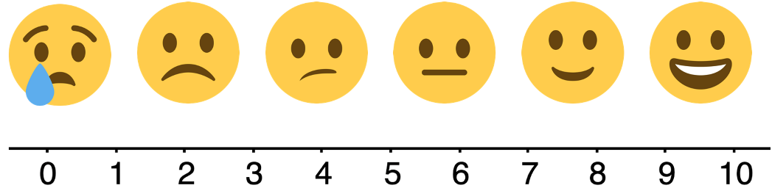
5.10.6 Wrap-Up: Reflection
Use the emoji scale to indicate your level of confidence with using ratios to convert units within the same measurement system.
Explain why you indicated the confidence level above.
volume 1, pg. 224

